Slide 1
Introduction to OpenACC
Bharat Kumar
Notes:
Introduction to parallel programming and OpenACC. This is a very conceptual approach, and is intended for students with little to no parallel programming experience.

Slide 2
Lecture 1 Outline
Topics to be covered
What is OpenACC and Why Should You Care?
Profile-driven Development
First Steps with OpenACC
Week 1 Lab
Where to Get Help

Slide 3
Introduction to Openacc
Notes:
No coding yet. Just explaining what OpenACC is, it’s weaknesses/limitations, and why it’s worth learning.

Slide 4
3 Ways to Accelerate Applications
Applications
Libraries
Compiler Directives
Programming Languages
Easy to use
Most Performance
Easy to use
Portable code
Most Performance
Most Flexibility
OpenACC
Notes:
Libraries are limited by what is included within the library. The programmer is not able to make changes that are not defined in the library. If the programmer needs to do something not defined in the library, there isn’t really a solution for it. This is very high performance, but only if the operations you want to do are available in a library form.
Programming Languages require a programmer to recreate their sequential program from scratch and maintain both serial and parallel versions of their key operations. The programmer can micro-manage everything about their program and often use device-specific features too specific for higher-level approaches in order to achieve the best performance. Parallel programs created in a parallel programming languages tend to only work on a very small number of platforms.
Compiler directives sit in the middle and blend the flexibility of programming languages with the ease of use of libraries. The programmer annotates the code with high-level instructions that a compiler can use to parallelize the code or can safely ignore. This means that a code with compiler directives can be compiled for many different parallel platforms and there’s no need to maintain separate serial and parallel versions of the code.

Slide 5


OpenACC is…
a directives-based parallel programming model designed for performance and portability.
Add Simple Compiler Directive
main()
{
<serial code>
#pragma acc kernels
{
<parallel code>
}
}
Notes:
Simple, Powerful, Portable

Slide 6


OpenACC Directives
#pragma acc data copyin(a,b) copyout(c) { ... #pragma acc parallel
{
#pragma acc loop gang vector
for (i = 0; i < n; ++i) {
c[i] = a[i] + b[i];
...
}
}
...
}
Manage Data Movement
Incremental
Single source
Initiate Parallel Execution
Interoperable
Performance portable
CPU, GPU, Manycore
Optimize
Loop Mappings
Notes:
OpenACC is a directive based parallel programming model for C, C++ and Fortran.
You use pragmas in C or C++ or specially formatted comments in Fortran to manage data movement between System Memory and GPU memory, to initiate parallel execution, and to optimize loop mappings. These pragmas and comments are ignored by a non-OpenACC compiler, so an OpenACC program remains portable to any other Fortran, C or C++ compiler or computing system.
Explain the directives, explain the benefits.
OpenACC is designed to be performance portable across processor architectures. Using OpenACC, you can write programs that will map efficiently not only to GPUs but also to multicore CPUs and Manycore processors. On a multicore CPU, any data directives in the code are just ignored, since it’s a shared memory system and the fact that there are two copies of a variable are implicit.
What does that look like in practice?

Slide 7
openacc
Incremental
Begin with a working sequential code.
Enhance Sequential Code
#pragma acc parallel loop
for( i = 0; i < N; i++ )
{
< loop code >
}
#pragma acc parallel loop
for( i = 0; i < N; i++ )
{
< loop code >
}
for( i = 0; i < N; i++ )
{
< loop code >
}
for( i = 0; i < N; i++ )
{
< loop code >
}
Maintain existing sequential code
Add annotations to expose parallelism
After verifying correctness, annotate more of the code
Parallelize it with OpenACC.
Rerun the code to verify correctness and performance
Notes:
For the most part, we consider OpenACC to be an incremental programming model because we can start with a base, working code. So we start with a working code, then can make small changes until the code is optimal. Many other parallel programming models have you build the code from the ground up. This means that you make large changes at a time, and when something doesn’t work, you either scrap it, or debug it.

Slide 8
openacc
The compiler can ignore your OpenACC code additions, so the same code can be used for parallel or sequential execution.
Supported Platforms
Single Source
POWER
Sunway
x86 CPU
AMD GPU
NVIDIA GPU
PEZY-SC
Rebuild the same code on multiple architectures
Compiler determines how to parallelize for the desired machine
Sequential code is maintained
int main(){
...
#pragma acc parallel loop
for(int i = 0; i < N; i++)
< loop code >
}
int main(){
...
for(int i = 0; i < N; i++)
< loop code >
}
Notes:
One of the main advantages of OpenACC is that you can run your program on several different parallel hardware without having to make any changes to the code. You may need to make small changes for the code to be optimal, but it is expected that any OpenACC parallel code can run relatively well on any of the supported hardware.

Slide 9

openacc
CPU
Parallel Hardware
Low Learning Curve
OpenACC is meant to be easy to use, and easy to learn
Programmer remains in familiar C, C++, or Fortran
No reason to learn low-level details of the hardware.
int main(){
<sequential code>
#pragma acc kernels
{
<parallel code>
}
}
The programmer will give hints to the compiler.
Compiler
Hint
The compiler parallelizes the code.
Notes:
Lastly, OpenACC is meant to be simple to learn/use. Outside of standard C/C++/Fortran coding, there are no new languages to learn.

Slide 10





Directive-based HPC programming
Who’s Using OpenACC?
3 of top 5 HPC Apps
5 of 13 CAAR Codes
Accelerated apps
725 TRAINED experts
Slack Members
160,000+ Downloads
Notes:
So who’s using it? Move through this slide quickly, just state three quick bullets:
Three of the top five HPC codes -- ANSYS, Gaussian, and VASP
Five of the thirteen CAAR codes running now on Summit – XGC, GTC, Flash, LSDalton, and ACME.
Over one hundred thousand downloads of PGI Community Edition compilers a year.
Three of the top five HPC codes according to the "HPC Application Support for GPU Computing 2017" report from Intersect360 have been ported or are being ported to GPUs using OpenACC directives. ANSYS, Gaussian and VASP. The latter having recently changed course from using CUDA to using OpenACC for maintainability reasons.
Five of the 13 codes selected by the Center for Accelerated Application Readiness at Oak Ridge National Laboratory in preparation for the delivery of the Summit system this year are using OpenACC directives to port to GPUs including XGC, GTC, Flash, LSDalton and ACME.
Overall, we here are NVIDIA are tracking nearly 200 HPC applications using directives to port to GPUs and on average two or three new ones are being added every month.
To date, ORNL and NVIDIA have conducted a total of 23 GPU hackathons worldwide. Through those events, we've trained over 725 domain experts from major HPC center all over the world on using directives and in the process, developed over 100 experts to help mentor others in the future.
In just under 2 years since it’s launch, almost 850 have joined the OpenACC slack channel where they can ask questions, share code samples, promote their work and learn about opportunities within the community to collaborate and publish their work.
Since it’s launch in November 2017, there have been over 160,000 downloads of the no-cost PGI Community Edition Fortran, C and C++ compiler suite with OpenACC. It’s found wide acceptance particularly in rapidly growing HPC regions in India and Asia.

Slide 11
Openacc syntax

Slide 12
Openacc syntax
Syntax for using OpenACC directives in code
C/C++
Fortran
#pragma acc directive clauses
<code>
!$acc directive clauses
<code>
A pragma in C/C++ gives instructions to the compiler on how to compile the code. Compilers that do not understand a particular pragma can freely ignore it.
A directive in Fortran is a specially formatted comment that likewise instructions the compiler in it compilation of the code and can be freely ignored.
“acc” informs the compiler that what will come is an OpenACC directive
Directives are commands in OpenACC for altering our code.
Clauses are specifiers or additions to directives.

Slide 13
Example code

Slide 14
Laplace heat transfer
Introduction to lab code - visual
Very Hot
Room Temp
We will observe a simple simulation of heat distributing across a metal plate.
We will apply a consistent heat to the top of the plate.
Then, we will simulate the heat distributing across the plate.

Slide 15


Example: Jacobi Iteration
Iteratively converges to correct value (e.g. Temperature), by computing new values at each point from the average of neighboring points.
Common, useful algorithm
Example: Solve Laplace equation in 2D: $∇^{2}f(x,y)=0$
A(i,j+1)
A(i-1,j)
A(i+1,j)
A(i,j)
$$A_{k+1}\left(i,j\right)=\frac{A_{k}(i−1,j)+A_{k}\left(i+1,j\right)+A_{k}\left(i,j−1\right)+A_{k}\left(i,j+1\right) }{4}$$
A(i,j-1)

Slide 16
Jacobi Iteration: C Code
Iterate until converged
while ( err > tol && iter < iter_max ) {
err=0.0;
for( int j = 1; j < n-1; j++) {
for(int i = 1; i < m-1; i++) {
Anew[j][i] = 0.25 * (A[j][i+1] + A[j][i-1] +
A[j-1][i] + A[j+1][i]);
err = max(err, abs(Anew[j][i] - A[j][i]));
}
}
for( int j = 1; j < n-1; j++) {
for( int i = 1; i < m-1; i++ ) {
A[j][i] = Anew[j][i];
}
}
iter++;
}
Iterate across matrix elements
Calculate new value from neighbors
Compute max error for convergence
Swap input/output arrays

Slide 17
Profile-Driven Development
Notes:
Running sequential code before any code edits to get baseline results.

Slide 18
Openacc development CYCLE
Analyze your code to determine most likely places needing parallelization or optimization.
Parallelize your code by starting with the most time consuming parts and check for correctness.
Optimize your code to improve observed speed-up from parallelization.
Analyze
Analyze
Optimize
Parallelize
Notes:
This is the OpenACC development cycle. Analyze -> Parallelize -> Optimize. Rinse and repeat. It is slightly over-simplified, however. It is very important to profile you code before beginning, however, it is equally important to continue profiling your code as you make changes. It is important to verify that changes you are making are impacting the code in a way that you expected.
The Modules are designed to follow this format. This Module will include the Analyze portion. We are expecting students to profile for every module, however.

Slide 19
Profiling sequential code
Profile Your Code
Lab Code: Laplace Heat Transfer
Obtain detailed information about how the code ran.
Total Runtime: 39.43 seconds
This can include information such as:
Total runtime
Runtime of individual routines
Hardware counters
Identify the portions of code that took the longest to run. We want to focus on these “hotspots” when parallelizing.
Notes:
The chart is from another sample code, one that the students are not expected to work with. We will create a similar graph with our lab code once we explain the profiling process.

Slide 20
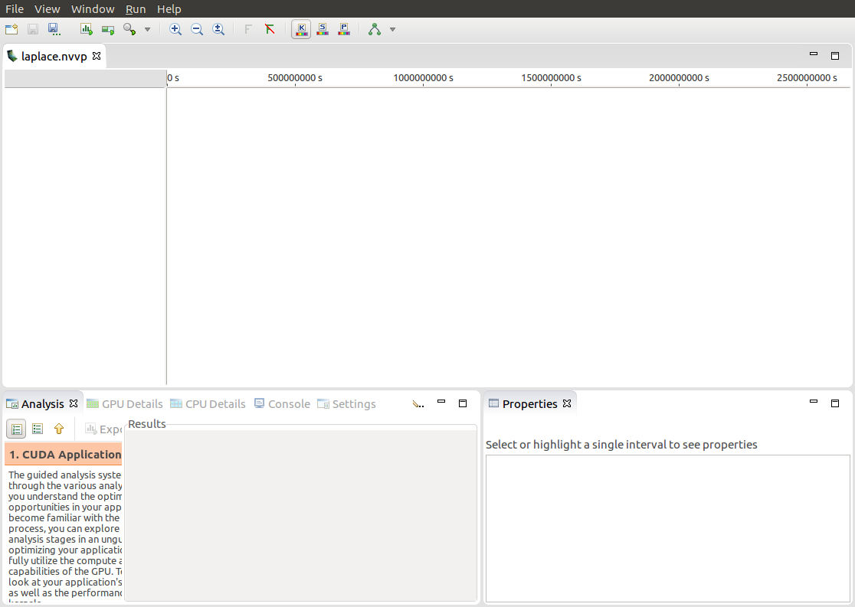
Profiling sequential code
First sight when using PGPROF
Profiling a simple, sequential code
Our sequential program will on run on the CPU
To view information about how our code ran, we should select the “CPU Details” tab
Notes:
This is what you’re greeted with when opening an executable in PGPROF. The screenshots will be of the laplace lab code, so when students go through the lab, they should see very similar results.
Since we are running the code sequentially, only the CPU will be active. We can select “CPU Details” to view additional information about the CPU.

Slide 21
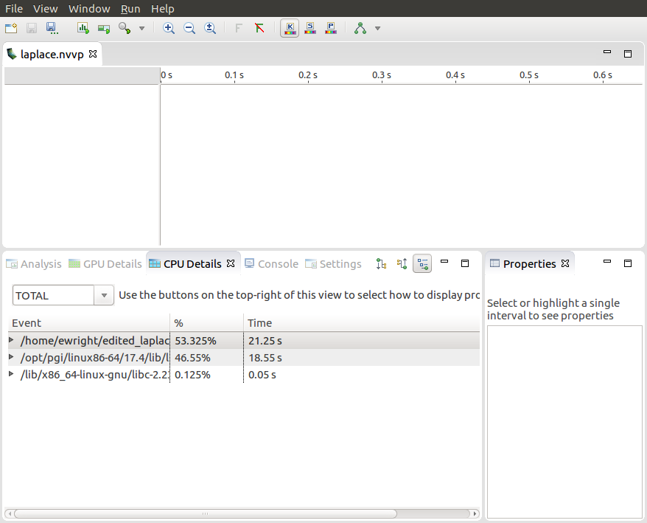
Profiling sequential code
CPU Details
Within the “CPU Details” tab, we can see the various parts of our code, and how long they took to run
We can reorganize this info using the three options in the top-right portion of the tab
We will expand this information, and see more details about our code
Notes:
This is a view of the CPU details, where we can see which parts of our code took the longest to run, and how long each portion took. I have highlighted a few options in the top-left hand corner of the CPU Details window, these are different views, and will display the CPU Details in a different way.

Slide 22
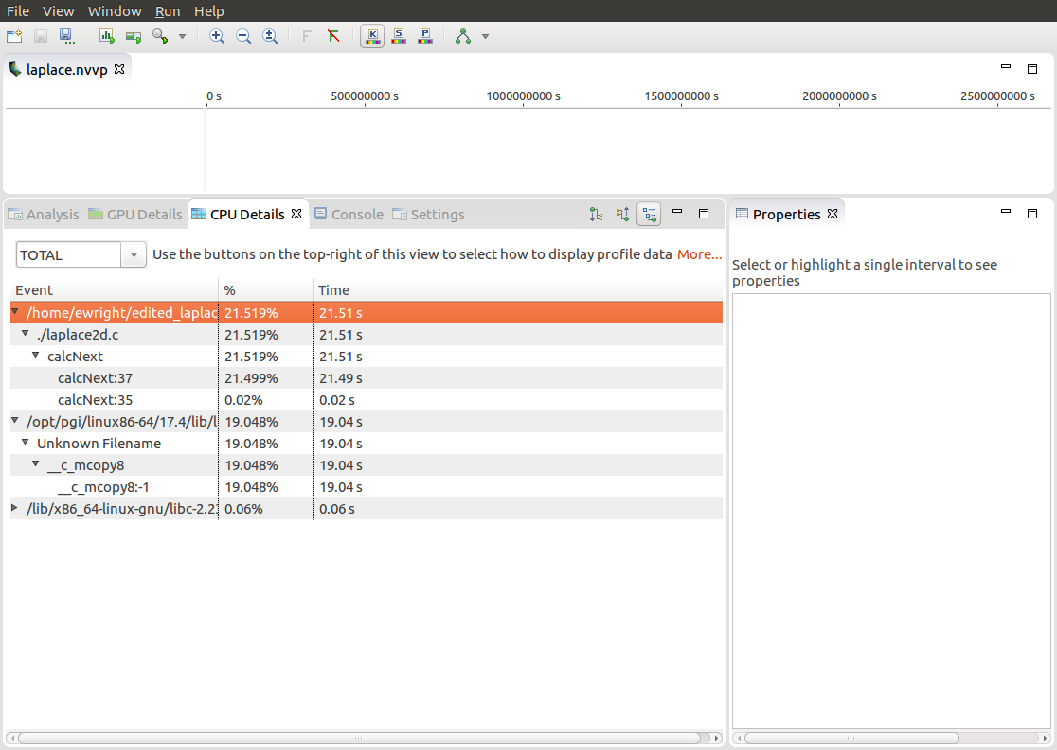
Profiling sequential code
CPU Details
We can see that there are two places that our code is spending most of its time
21.49 seconds in the “calcNext” function
19.04 seconds in a memcpy function
The c_mcopy8 that we see is actually a compiler optimization that is being applied to our “swap” function
Notes:
We are seeing that the majority of our program is spend in a function called “calcNext” and “__c_mcopy8”
The calcNext is our code from the laplace code, while the __c_mcopy8 is a memory copy. We can also see that the calcNext takes slightly longer than the memcpys.

Slide 23
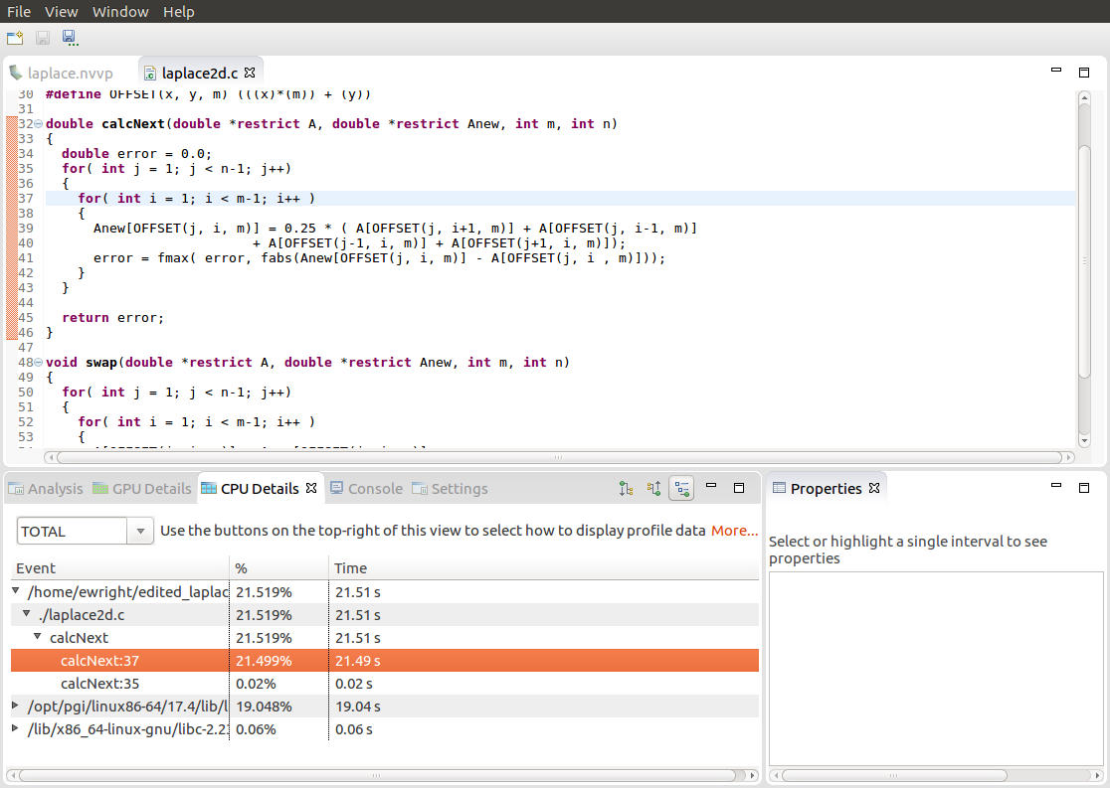
Profiling sequential code
PGPROF
We are also able to select the different elements in the CPU Details by double-clicking to open the associated source code
Here we have selected the “calcNext:37” element, which opened up our code to show the exact line (line 37) that is associated with that element
Notes:
The code is opened, and the line in question is highlighted. The code that is being detected is the code within our main loop. This is exactly what we were expecting.
Knowing this information, it makes sense why we focused on parallelizing this loop in the lab assignment, because it accounts for our entire program.

Slide 24
Openacc parallel Loop directive
Notes:
The parallel directive is fairly similar to the kernels directive in function. But how you use it is fairly different.

Slide 25
Openacc parallel directive
Expressing parallelism
#pragma acc parallel
{
}
gang
gang
When encountering the parallel directive, the compiler will generate 1 or more parallel gangs, which execute redundantly.
gang
gang
gang
gang
Notes:
Each of these gangs can have 1 or more computational threads (meaning that it can execute code). For example, when programming with a multicore CPU, each gang will have 1 thread. Other architectures can have more. A GPU, for example may have hundreds of threads per gang.

Slide 26
Openacc parallel directive
Expressing parallelism
loop
loop
#pragma acc parallel
{
for(int i = 0; i < N; i++)
{
// Do Something
}
}
#pragma acc parallel
{
}
gang
gang
loop
loop
loop
gang
gang
loop
loop
This loop will be executed redundantly on each gang
gang
gang
Notes:
This for loop does not have a loop directive, meaning that it will be redundantly parallelized. Every gang will run the loop in its entirety. Each gang will execute at the same time, and independent of each other.

Slide 27
Openacc parallel directive
Expressing parallelism
#pragma acc parallel
{
for(int i = 0; i < N; i++)
{
// Do Something
}
}
#pragma acc parallel
{
}
gang
gang
gang
gang
This means that each gang will execute the entire loop
gang
gang
Notes:
This for loop does not have a loop directive, meaning that it will be redundantly parallelized. Every gang will run the loop in its entirety. Each gang will execute at the same time, and independent of each other.

Slide 28
Openacc parallel directive
Expressing parallelism
#pragma acc parallel
{
for(int i = 0; i < N; i++)
{
// Do Something
}
}
#pragma acc parallel
{
#pragma acc loop
for(int i = 0; i < N; i++)
{
// Do Something
}
}
The loop directive informs the compiler which loops to parallelize.
Notes:
Now that we have surrounded the loop with a loop directive, the loop iterations will be distributed relatively evenly among the gangs. Each gang has some number of threads, and will have those threads execute the loop iterations. The loop iterations will (for the most part) be split up evenly among the gangs/threads. There are many optimizations that can occur based on how the threads within the gangs work, or how the loop iterations are distributed. However, that is a topic for its own module.

Slide 29
Openacc parallel directive
Parallelizing a single loop
C/C++
#pragma acc parallel
{
#pragma acc loop
for(int i = 0; j < N; i++)
a[i] = 0;
}
Use a parallel directive to mark a region of code where you want parallel execution to occur
This parallel region is marked by curly braces in C/C++ or a start and end directive in Fortran
The loop directive is used to instruct the compiler to parallelize the iterations of the next loop to run across the parallel gangs
Fortran
!$acc parallel
!$acc loop
do i = 1, N
a(i) = 0
end do
!$acc end parallel
Notes:
This slide should stress that the PARALLEL directive creates the parallelism on which to run, but the loop directive informs the compiler which loops to parallelize. Either directive by itself is not very useful.

Slide 30
Openacc parallel directive
Parallelizing a single loop
C/C++
This pattern is so common that you can do all of this in a single line of code
In this example, the parallel loop directive applies to the next loop
This directive both marks the region for parallel execution and distributes the iterations of the loop.
When applied to a loop with a data dependency, parallel loop may produce incorrect results
#pragma acc parallel loop
for(int i = 0; j < N; i++)
a[i] = 0;
Fortran
!$acc parallel loop
do i = 1, N
a(i) = 0
end do
Notes:
The core difference between parallel and kernels, the parallel directive is completely programmer based. It gives the programmer much more control over the code.

Slide 31
Parallelize with OpenACC Parallel Loop
while ( err > tol && iter < iter_max ) {
err=0.0;
#pragma acc parallel loop reduction(max:err)
for( int j = 1; j < n-1; j++) {
for(int i = 1; i < m-1; i++) {
Anew[j][i] = 0.25 * (A[j][i+1] + A[j][i-1] +
A[j-1][i] + A[j+1][i]);
err = max(err, abs(Anew[j][i] - A[j][i]));
}
}
#pragma acc parallel loop
for( int j = 1; j < n-1; j++) {
for( int i = 1; i < m-1; i++ ) {
A[j][i] = Anew[j][i];
}
}
iter++;
}
Parallelize first loop nest, max reduction required.
Parallelize second loop.
We didn’t detail how to parallelize the loops, just which loops to parallelize.
Notes:
Explain what’s meant by a reduction.

Slide 32
reduction clause
The reduction clause takes many values and “reduces” them to a single value, such as in a sum or maximum
Each thread calculates its part
The compiler will perform a final reduction to produce a single global result using the specified operation
for( i = 0; i < size; i++ )
for( j = 0; j < size; j++ )
for( k = 0; k < size; k++ )
c[i][j] += a[i][k] * b[k][j];
for( i = 0; i < size; i++ )
for( j = 0; j < size; j++ )
double tmp = 0.0f;
#pragma parallel acc loop \ reduction(+:tmp)
for( k = 0; k < size; k++ )
tmp += a[i][k] * b[k][j];
c[i][j] = tmp;

Slide 33
reduction clause operators
Operator Description Example
+ Addition/Summation reduction(+:sum)
* Multiplication/Product reduction(*:product)
max Maximum value reduction(max:maximum)
min Minimum value reduction(min:minimum)
& Bitwise and reduction(&:val)
| Bitwise or reduction(|:val)
&& Logical and reduction(&&:val)
|| Logical or reduction(||:val)

Slide 34
Build and Run the Code

Slide 35
PGI Compiler Basics
pgcc, pgc++ and pgfortran
The command to compile C code is ‘pgcc’
The command to compile C++ code is ‘pgc++’
The command to compile Fortran code is ‘pgfortran’
The -fast flag instructs the compiler to optimize the code to the best of its abilities
$ pgcc –fast main.c
$ pgc++ -fast main.cpp
$ pgfortran –fast main.F90

Slide 36
PGI Compiler Basics
-Minfo flag
The -Minfo flag will instruct the compiler to print feedback about the compiled code
-Minfo=accel will give us information about what parts of the code were accelerated via OpenACC
-Minfo=opt will give information about all code optimizations
-Minfo=all will give all code feedback, whether positive or negative
$ pgcc –fast –Minfo=all main.c
$ pgc++ -fast -Minfo=all main.cpp
$ pgfortran –fast –Minfo=all main.f90
Notes:
-Minfo=accel will only show any feedback if there are OpenACC optimizations.
-Minfo=opt will give us a lot of information regarding optimizations (this includes non-parallel optimizations as well!)
-Minfo=all will give more feedback, and will even give feedback about the sequential code. It can be overwhelming for individuals who are not used to things such as loop unrolling, or fused instructions. It will also give negative feedback (where code couldn’t be optimized, for example)

Slide 37
PGI Compiler Basics
pgcc, pgc++ and pgfortran
Use pgcc, pgc++, and pgfortran to compile for C, C++, Fortran
The -ta flag enables building OpenACC code for a “Target Accelerator” (TA)
-ta=multicore – Build the code to run across threads on a multicore CPU
-ta=tesla:managed – Build the code for an NVIDIA (Tesla) GPU and manage the data movement for me (more next week)
$ pgcc –fast –Minfo=accel –ta=tesla:managed main.c
$ pgc++ -fast -Minfo=accel –ta=tesla:managed main.cpp
$ pgfortran –fast –Minfo=accel –ta=tesla:managed main.f90
Notes:
-Minfo=accel will only show any feedback if there are OpenACC optimizations.
-Minfo=opt will give us a lot of information regarding optimizations (this includes non-parallel optimizations as well!)
-Minfo=all will give more feedback, and will even give feedback about the sequential code. It can be overwhelming for individuals who are not used to things such as loop unrolling, or fused instructions. It will also give negative feedback (where code couldn’t be optimized, for example)

Slide 38
Building the code (multicore)
$ pgcc -fast -ta=multicore -Minfo=accel laplace2d_uvm.c
main:
63, Generating Multicore code
64, #pragma acc loop gang
64, Accelerator restriction: size of the GPU copy of Anew,A is unknown
Generating reduction(max:error)
66, Loop is parallelizable
74, Generating Multicore code
75, #pragma acc loop gang
75, Accelerator restriction: size of the GPU copy of Anew,A is unknown
77, Loop is parallelizable
Notes:
PGI 17.5 does not build for cc60 by default, so it’s necessary to include that in the –ta line. That is not necessary when building for earlier chips

Slide 39
OpenACC Speed-up
PGI 18.7, NVIDIA Tesla V100, Intel i9-7900X CPU @ 3.30GHz

Slide 40
Building the code (GPU)
$ pgcc -fast -ta=tesla:managed -Minfo=accel laplace2d_uvm.c
main:
63, Accelerator kernel generated
Generating Tesla code
64, #pragma acc loop gang /* blockIdx.x */
Generating reduction(max:error)
66, #pragma acc loop vector(128) /* threadIdx.x */
63, Generating implicit copyin(A[:])
Generating implicit copyout(Anew[:])
Generating implicit copy(error)
66, Loop is parallelizable
74, Accelerator kernel generated
Generating Tesla code
75, #pragma acc loop gang /* blockIdx.x */
77, #pragma acc loop vector(128) /* threadIdx.x */
74, Generating implicit copyin(Anew[:])
Generating implicit copyout(A[:])
77, Loop is parallelizable
Notes:
PGI 17.5 does not build for cc60 by default, so it’s necessary to include that in the –ta line. That is not necessary when building for earlier chips

Slide 41
OpenACC Speed-up
PGI 18.7, NVIDIA Tesla V100, Intel i9-7900X CPU @ 3.30GHz

Slide 42
Closing Remarks

Slide 43
KEY concepts
This week we discussed…
What is OpenACC
How profile-driven programming helps you write better code
How to parallelize loops using OpenACC’s parallel loop directive to improve time to solution
Next Lecture:
Managing your data with OpenACC

Slide 44






OPENACC Resources
Guides ● Talks ● Tutorials ● Videos ● Books ● Spec ● Code Samples ● Teaching Materials ● Events ● Success Stories ● Courses ● Slack ● Stack Overflow
Resources
https://www.openacc.org/resources
Success Stories https://www.openacc.org/success-stories
FREE
Compilers
Compilers and Tools https://www.openacc.org/tools
Events
https://www.openacc.org/events
Notes:
Resources for various things relating to OpenACC. The two recommended, free compilers for OpenACC are PGI and GCC. OpenACC is a new edition to GCC, and all of OpenACC’s features may not be supported yet.

